Slide 1
KINEMATICS AND KINETIC OF RIGID BODIES

Slide 2
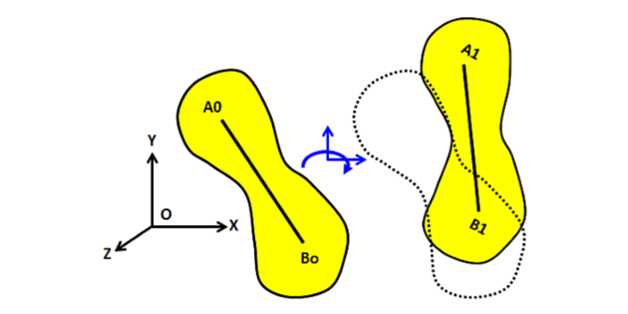
WHICH TYPE OF OBJECT IS CONSIDRED AS A RIGID BODY?
A RIGID BODY IS ONE IN WHICH THE DISTANCE BETWEEN ANY TWO POINTS DOES NOT CHANGE DUE TO AN APPLICATION OF EXTERNAL FORCES ON IT.

Slide 3

Types of rigid body motion
TRANSLATION
A rigid body is said to have translatory motion if an imaginary straight line is drawn on the body remains parallel to the original position during its motion.
For example the line AB drawn
Will remains as it is during
Translation.
B
A

Slide 4
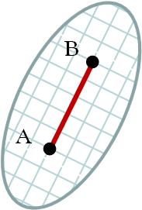
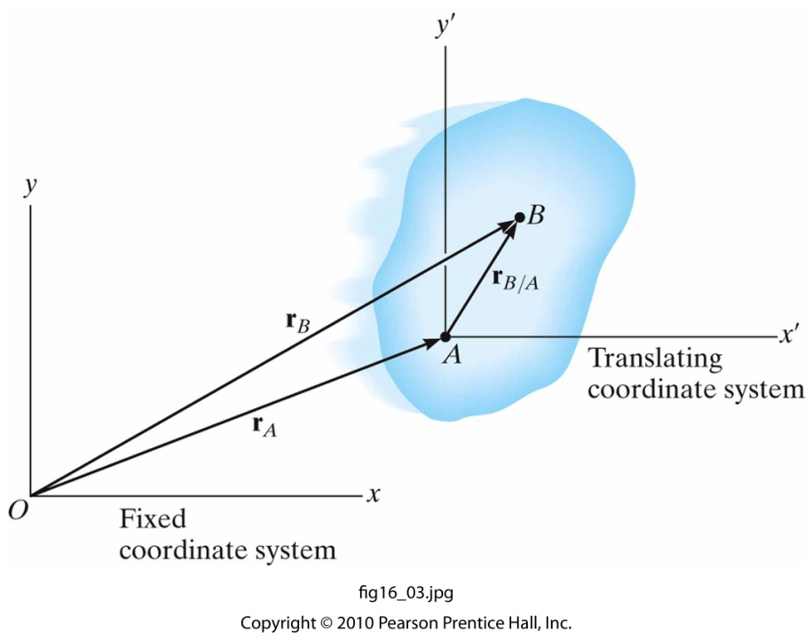
Kinematics of translation
Kinematics
Position
Velocity
Acceleration
True for all points in a rigid body. (follows particle kinematics)
y
B
r_{B}
A
r_{A}
x
fixed in the body
Notes:
A simpler way of saying this → rb/a = constant (since it is a rigid body)

Slide 5
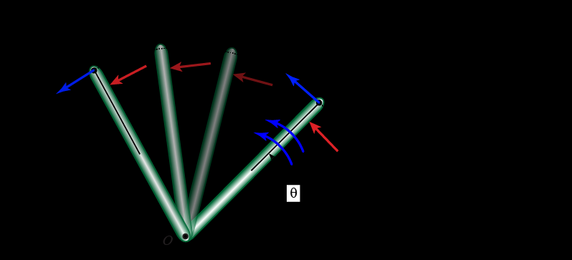
ROTATION
In case of rotation, all the particles of a rigid body will move in concentric circular paths.
. The common centre of the circles may be located within or outside the body .
.

Slide 6
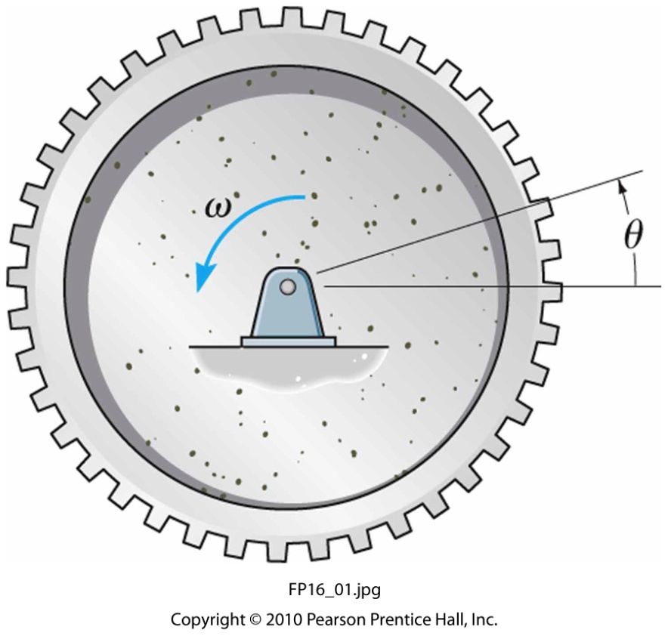
Example problem 1
When the gear rotates 20 revolutions, it achieves an angular velocity of ω = 30 rad/s, starting from rest. Determine its constant angular acceleration and the time required.

Slide 7
Example problem 2
A disk is originally rotating at ω₀ = 8 rad/s. If it is subjected to a constant angular acceleration of α = 6 rad/s², determine the magnitudes of the velocity and the n and t components of acceleration of point A at the instant t = 0.5 s.

Slide 8
EXAMPLE PROBLEM 3
A wheel is attached to the shaft of an electric motor of rated speed of 200 rpm . when the power is switched on the unit it attains the rated speed in 10 s and when the power is switched off, the unit comes to rest in 100s. Assume uniformly accelerated motion and determine a. the number of revolutions the unit turns to attain the rated speed b) to come to rest

Slide 9
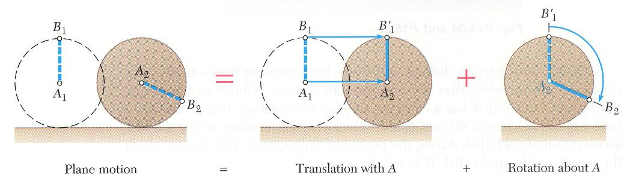
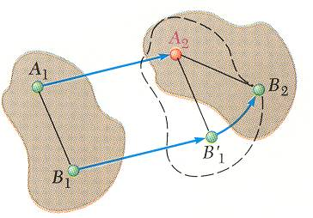
General Plane Motion
General plane motion is neither a translation nor a rotation.
General plane motion can be considered as the sum of a translation and rotation.
Displacement of particles A and B to A₂ and B₂ can be divided into two parts:
translation to A₂ and
rotation of about A₂ to B₂

Slide 10
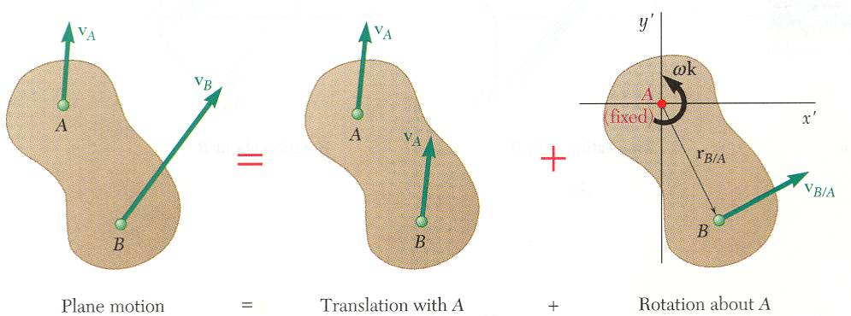
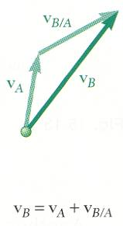
Absolute and Relative Velocity in Plane Motion
Any plane motion can be replaced by a translation of an arbitrary reference point A and a simultaneous rotation about A.

Slide 11
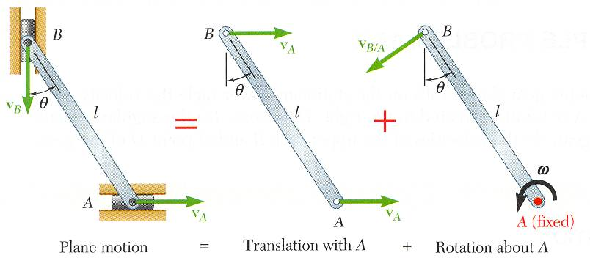
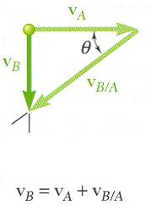
Absolute and Relative Velocity in Plane Motion
Assuming that the velocity v_{A} of end A is known, wish to determine the velocity v_{B} of end B and the angular velocity ω in terms of v_{A}, l, and θ.
The direction of v_{B} and v_{B/A} are known. Complete the velocity diagram.

Slide 12
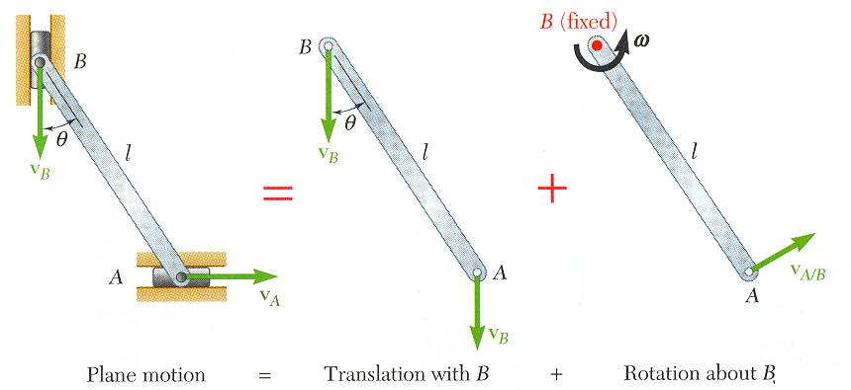
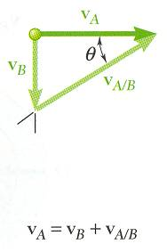
Absolute and Relative Velocity in Plane Motion
Selecting point B as the reference point and solving for the velocity v_{A} of end A and the angular velocity ω leads to an equivalent velocity triangle.
v_{A/B} has the same magnitude but opposite sense of v_{B/A}. The sense of the relative velocity is dependent on the choice of reference point.
Angular velocity ω of the rod in its rotation about B is the same as its rotation about A. Angular velocity is not dependent on the choice of reference point.

Slide 13
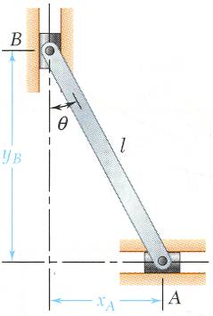
Analysis of Plane Motion in Terms of a Parameter
In some cases, it is advantageous to determine the absolute velocity and acceleration of a mechanism directly.

Slide 14
Example problem 4
The bar AB of length 5m slides in xy plane. The velocity of point A shown is 10 m/s downwards and makes an angle 60 degree with vertical. Determine the velocity of point B and mid-point C.

Slide 15
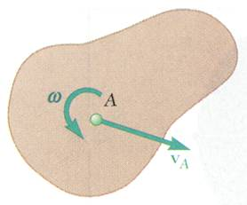
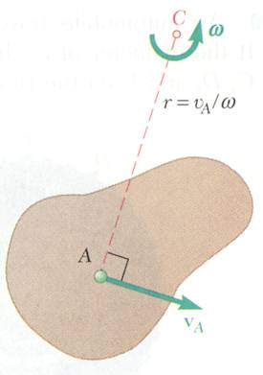
Instantaneous Center of Rotation in Plane Motion
Plane motion of all particles in a slab can always be replaced by the translation of an arbitrary point A and a rotation about A with an angular velocity that is independent of the choice of A.
The same translational and rotational velocities at A are obtained by allowing the slab to rotate with the same angular velocity about the point C on a perpendicular to the velocity at A.
The velocity of all other particles in the slab are the same as originally defined since the angular velocity and translational velocity at A are equivalent.
As far as the velocities are concerned, the slab seems to rotate about the instantaneous center of rotation C.

Slide 16
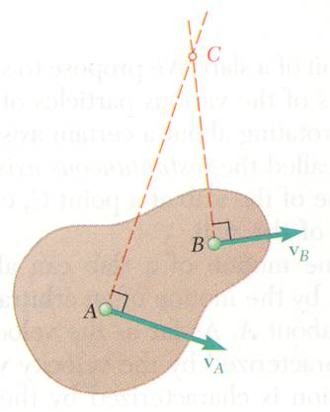
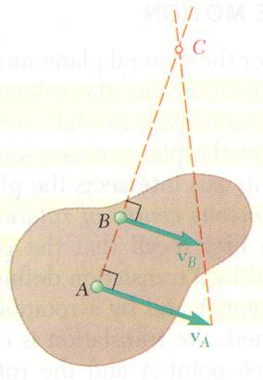
Instantaneous Center of Rotation in Plane Motion
If the velocity at two points A and B are known, the instantaneous center of rotation lies at the intersection of the perpendiculars to the velocity vectors through A and B .
If the velocity vectors are parallel, the instantaneous center of rotation is at infinity and the angular velocity is zero.
If the velocity vectors at A and B are perpendicular to the line AB, the instantaneous center of rotation lies at the intersection of the line AB with the line joining the extremities of the velocity vectors at A and B.
If the velocity magnitudes are equal, the instantaneous center of rotation is at infinity and the angular velocity is zero.

Slide 17
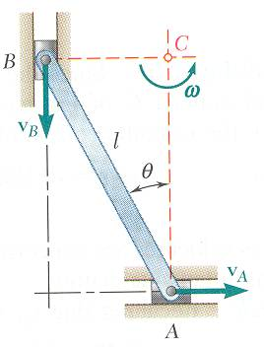
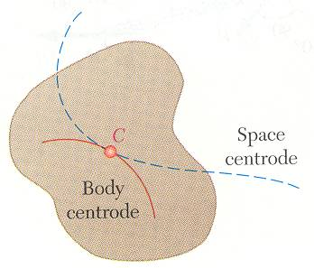
Instantaneous Center of Rotation in Plane Motion
The instantaneous center of rotation lies at the intersection of the perpendiculars to the velocity vectors through A and B .
The velocities of all particles on the rod are as if they were rotated about C.
The particle at the center of rotation has zero velocity.
The particle coinciding with the center of rotation changes with time and the acceleration of the particle at the instantaneous center of rotation is not zero.
The acceleration of the particles in the slab cannot be determined as if the slab were simply rotating about C.
The trace of the locus of the center of rotation on the body is the body centrode and in space is the space centrode.

